Slide 1


Ateliers NRD Mai 2026
CH Saint-Anne - Service d’imagerie diagnostique et thérapeutique
Romain INGLEBERT, interne

Slide 2
Introduction
Clinique
Femme 54 ans. Apyrétique.
Bilan de céphalées chroniques, instabilité à la marche, vertiges.
Biologie
RAS
Antécédents
RAS

Slide 3
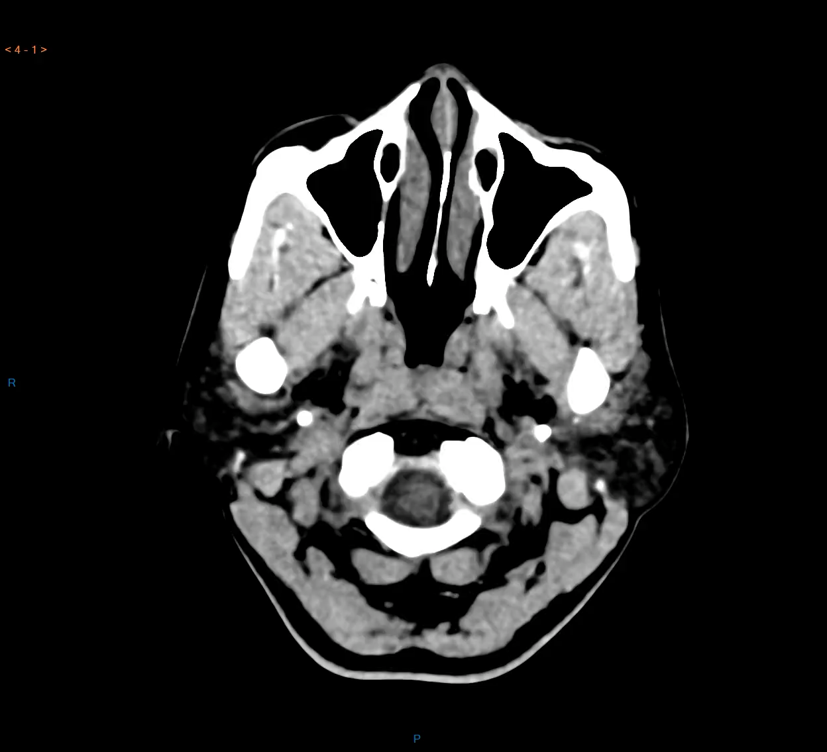
TDM C-
Notes:
TDM C- coupes axiales

Slide 4
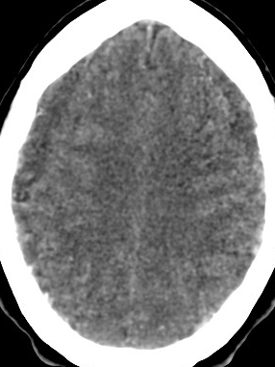
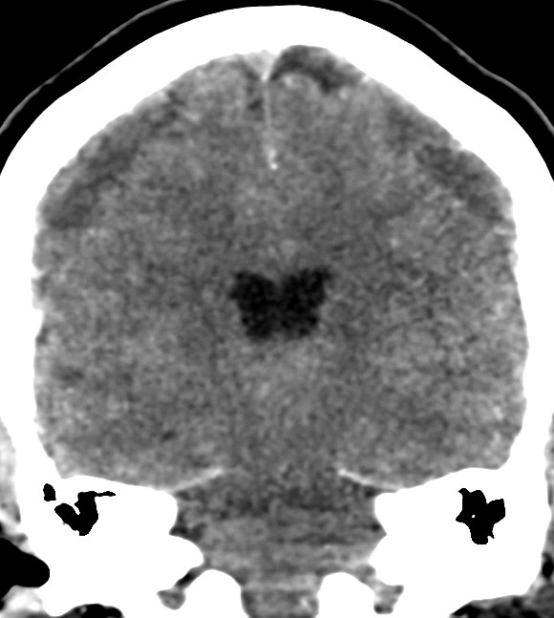
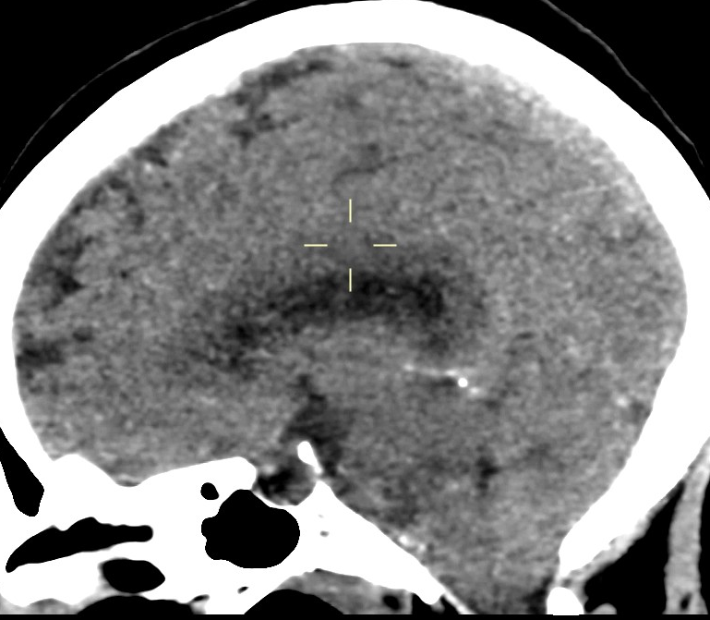
Notes:
TDM C- coupes axiales

Slide 5
>COLLECTIONS SOUS-DURALES BILATÉRALES
>AFFAISSEMENT DES STRUCTURES MÉDIANE
Notes:
TDM C- coupes axiales

Slide 6
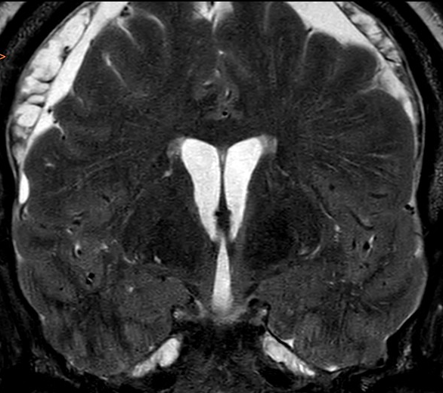
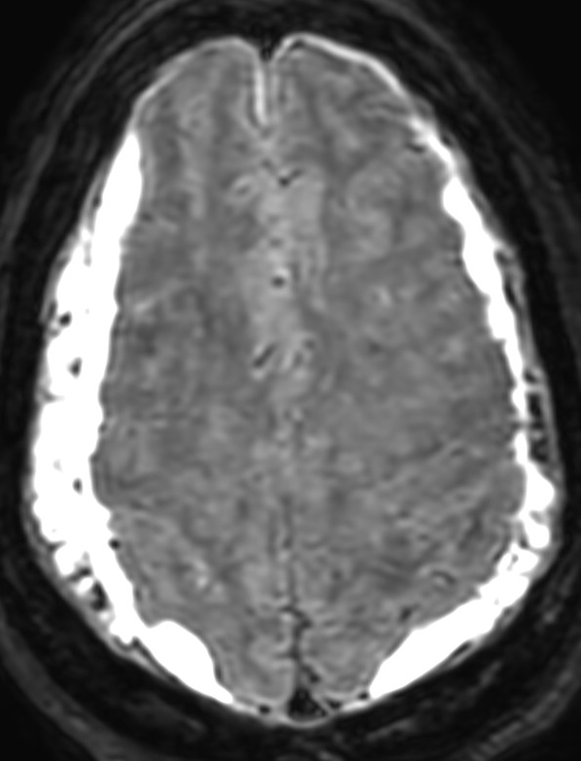
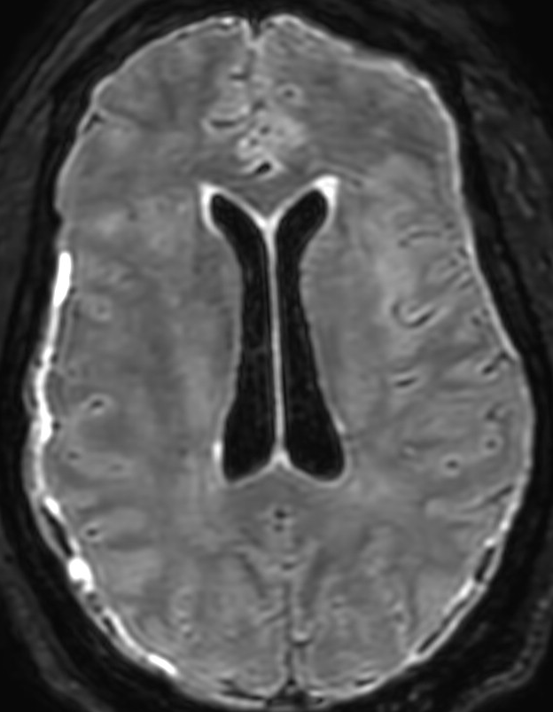
coro T2 TSE
3D FLAIR
Notes:
TDM C- coupes axiales

Slide 7
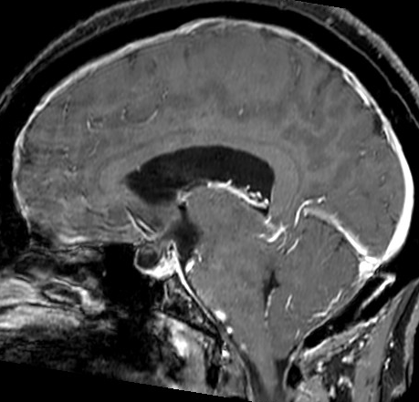
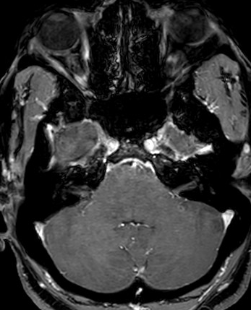
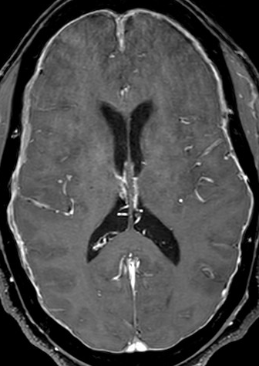
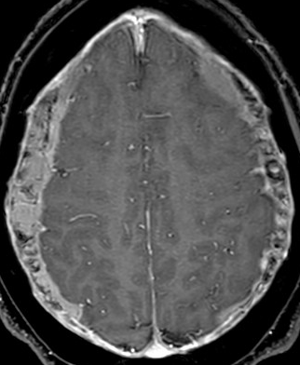
3D T1 EG iv+
Notes:
TDM C- coupes axiales

Slide 8
3D T1 EG iv+
HYPOTENSION INTRACRÂNIENNE
Notes:
TDM C- coupes axiales

Slide 9
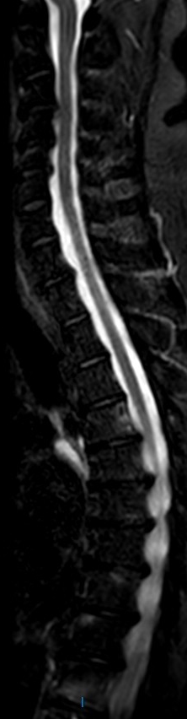
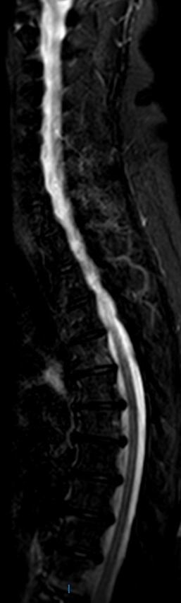
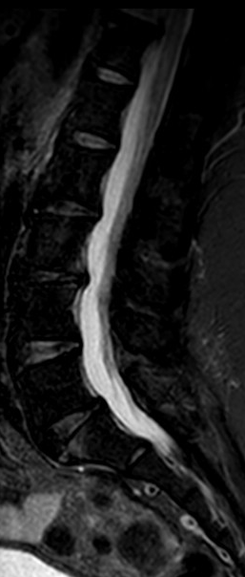
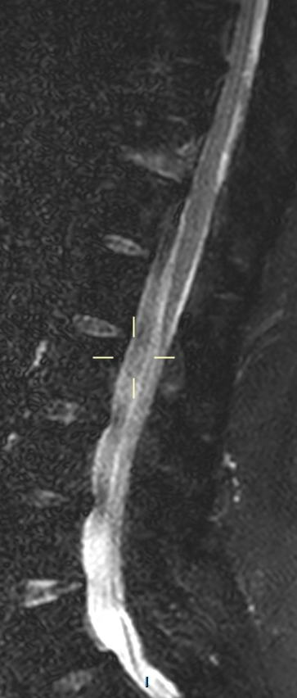
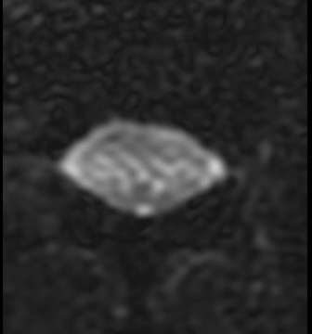
STIR
STIR
STIR
3D T2 FS TSE
3D T2 FS TSE, axiale L2
Notes:
TDM C- coupes axiales

Slide 10
STIR
STIR
STIR
3D T2 FS TSE
3D T2 FS TSE, axiale L2
SLEC -
Notes:
TDM C- coupes axiales

Slide 11
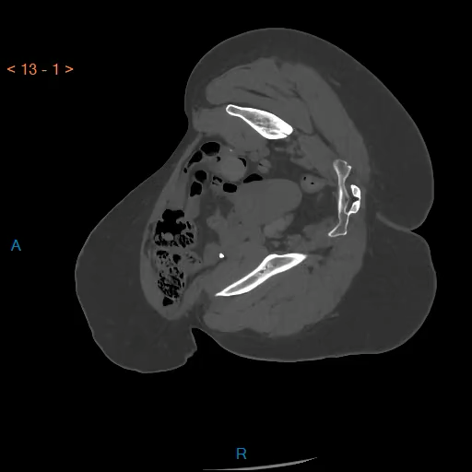
Myéloscanner, axiale
SLEC -
Notes:
TDM C- coupes axiales

Slide 12
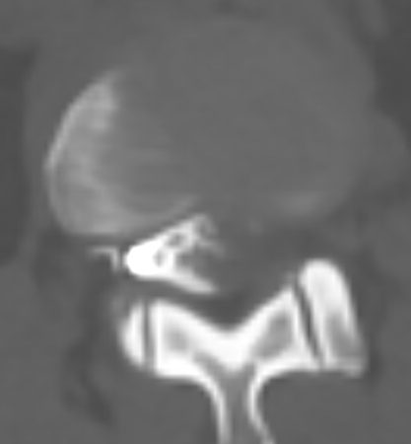
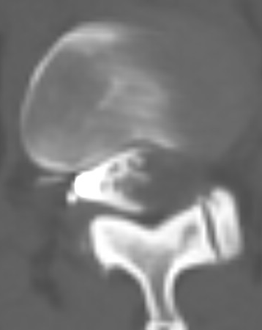
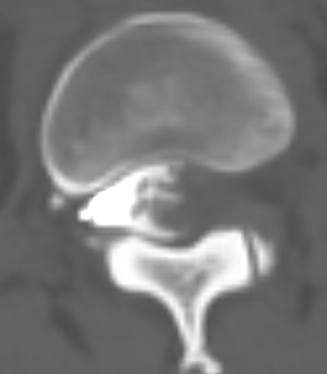
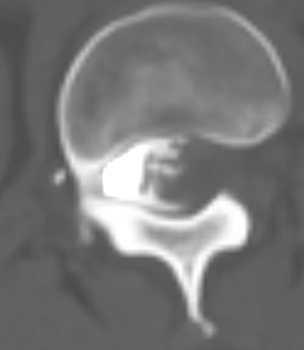
Myéloscanner, axiale
SLEC -
Notes:
TDM C- coupes axiales

Slide 13
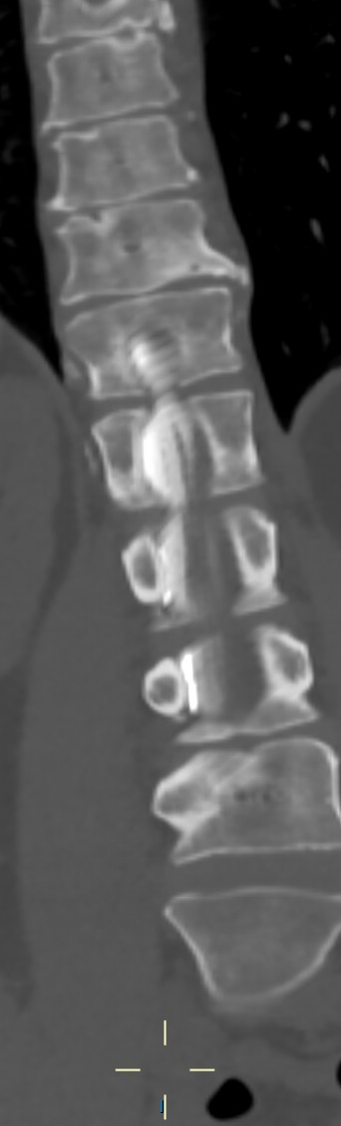
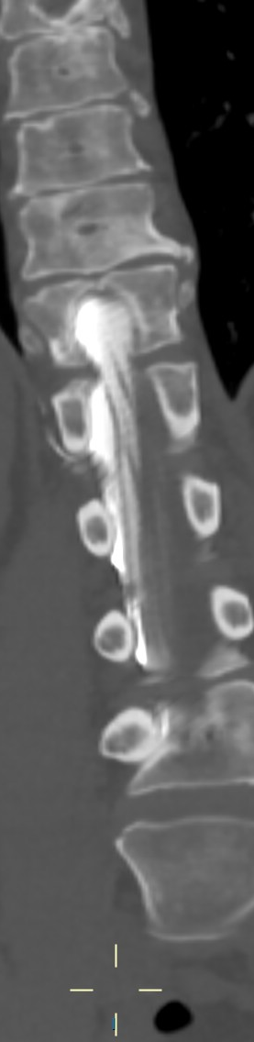

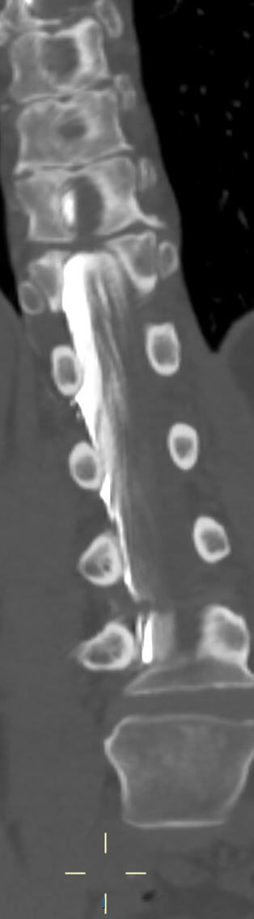

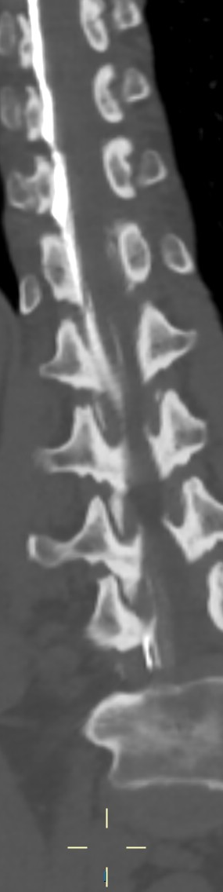
Myéloscanner
coronal
SLEC -
Notes:
TDM C- coupes axiales

Slide 14
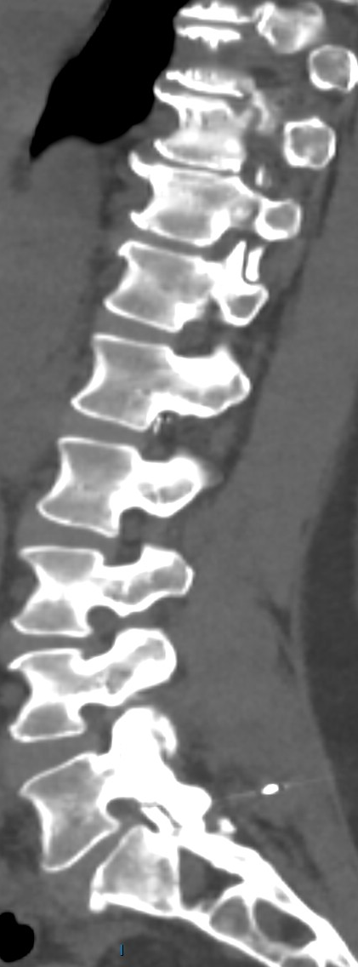
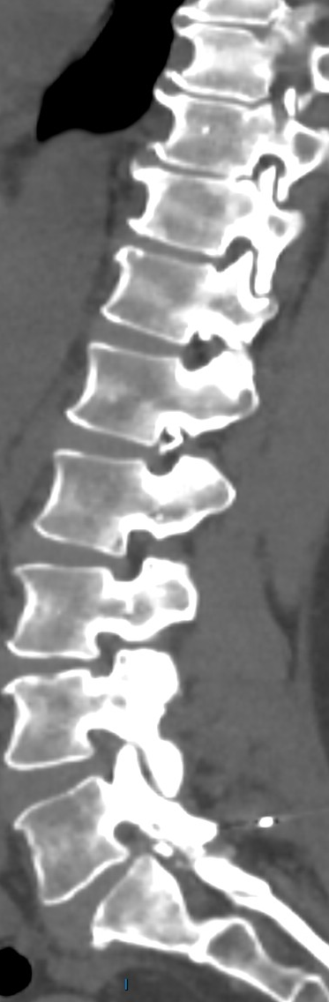
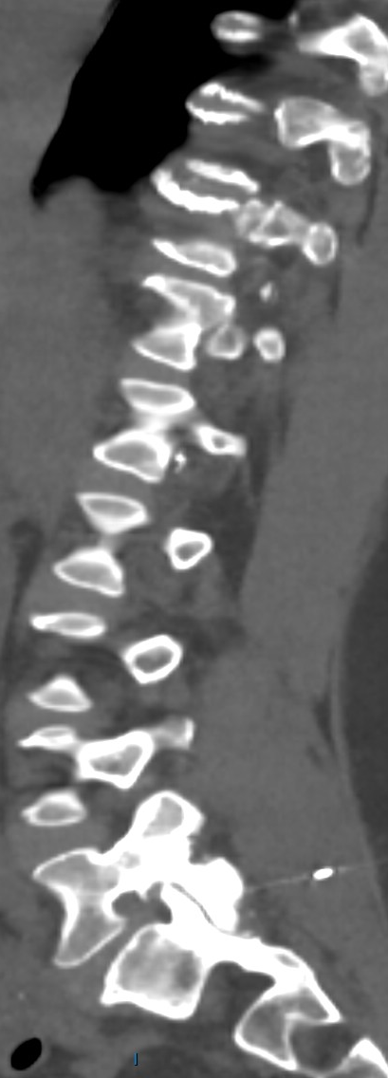
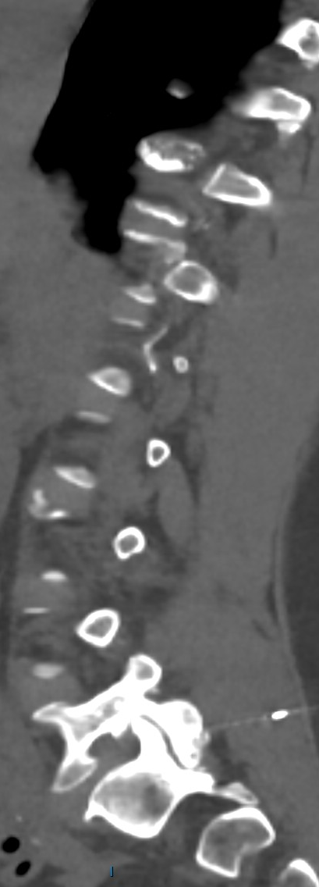
Myéloscanner
sagittal
SLEC -
Notes:
TDM C- coupes axiales

Slide 15
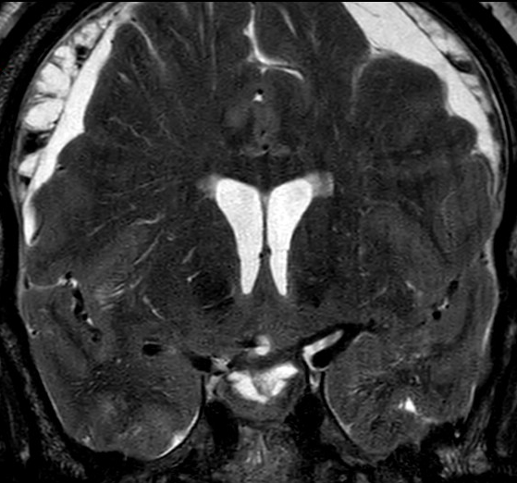
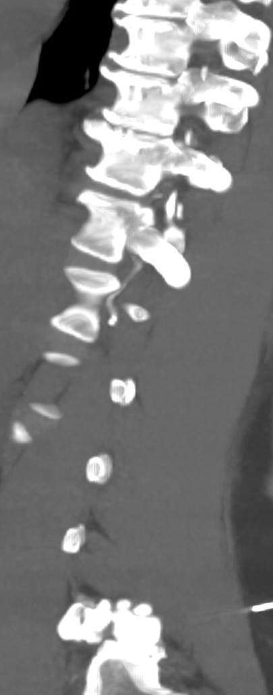
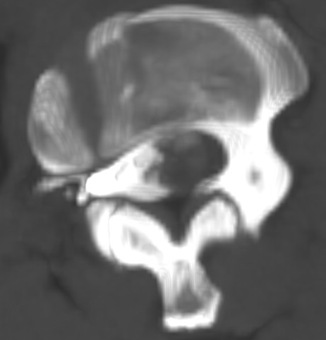
SLEC -
Notes:
TDM C- coupes axiales

Slide 16
FISTULE DURO-VEINEUSE (type 3)
SLEC -
Notes:
TDM C- coupes axiales

Slide 17
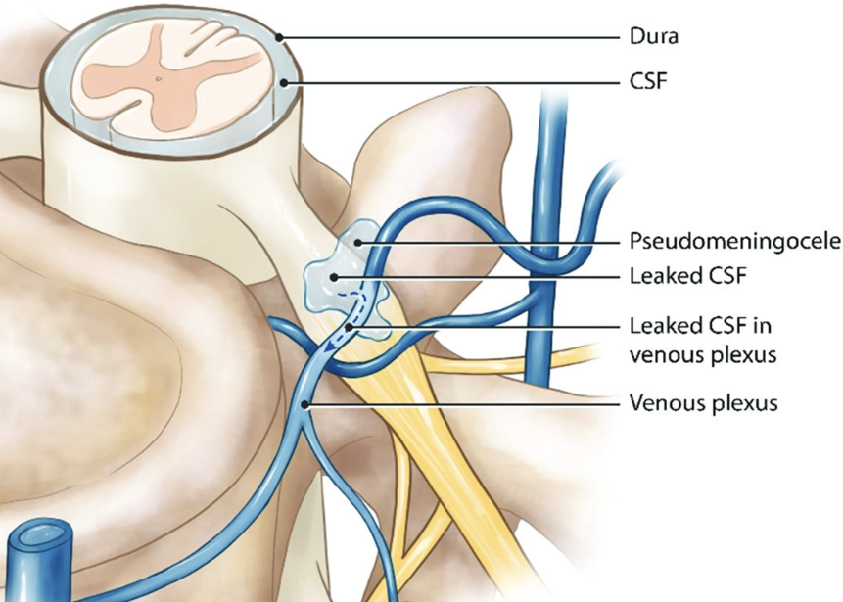
Au total
Hypotension intracrânienne spontanée sur fistule duro-veineuse (fuite type 3)
IV+ 4’
IRM cérébrale
Hypotension intracrânienne
IRM médullaire
Absence de collection épidurale (SLEC-P), pas de cible
Myéloscanner dynamique
Fuite de produit de contraste iodé en dehors du compartiment épidural,
fistule duro-veineuse (fuite type 3)
-> Régression de la symptomatologie après traitement endovasculaire

Slide 18
Merci !
- Bergui et al, 2024. CSF-venous leak responsible for spontaneous intracranial hypotension treated by endovascular venous route: First cases in Italy. Interv Neuroradiol 30, 428–432. https://doi.org/10.1177/15910199221116011
- Cheng et al, 2025. Diagnostic analysis of a new sign (superior sagittal sinus distention) on spontaneous intracranial hypotension MR imaging: a retrospective study. BMC Med Imaging 25, 425. https://doi.org/10.1186/s12880-025-01975-9
- Ciceri et al, 2025. Recommendations for the diagnosis and treatment of spontaneous intracranial hypotension. Radiol med 131, 332–339. https://doi.org/10.1007/s11547-025-02116-6
- Dobrocky et al, 2019. Assessing Spinal Cerebrospinal Fluid Leaks in Spontaneous Intracranial Hypotension With a Scoring System Based on Brain Magnetic Resonance Imaging Findings. JAMA Neurol 76, 580. https://doi.org/10.1001/jamaneurol.2018.4921
- Farb et al, 2019. Spontaneous Intracranial Hypotension: A Systematic Imaging Approach for CSF Leak Localization and Management Based on MRI and Digital Subtraction Myelography. AJNR. https://doi.org/10.3174/ajnr.A6016
- Houk et al, 2023. Validity of the Bern Score as a Surrogate Marker of Clinical Severity in Patients with Spontaneous Intracranial Hypotension. AJNR. https://doi.org/10.3174/ajnr.A7962
- Huynh et al, 2024. Lateral Decubitus Dynamic CT Myelography with Real-Time Bolus Tracking (dCTM-BT) for Evaluation of CSF-Venous Fistulas: Diagnostic Yield Stratified by Brain Imaging Findings. AJNR Am J Neuroradiol 45, 105–112. https://doi.org/10.3174/ajnr.A8082
- Jurcau et al, 2024. Spontaneous Intracranial Hypotension: Case Report and Update on Diagnosis and Treatment. Diagnostics 14, 881. https://doi.org/10.3390/diagnostics14090881
- Luetzen et al, 2021. Spontaneous intracranial hypotension: diagnostic and therapeutic workup. Neuroradiology 63, 1765–1772. https://doi.org/10.1007/s00234-021-02766-z
- Schievink et al, 2016. A classification system of spontaneous spinal CSF leaks. Neurology 87, 673–679. https://doi.org/10.1212/WNL.0000000000002986

