Slide 1

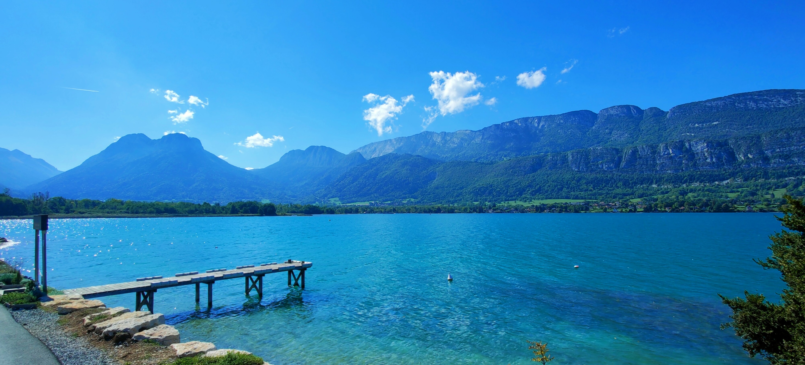
Bienvenue aux Ateliers de Neuroradiologie Diagnostique de la SFNR
Fondation Mérieux Les Pensières – Veyrier du Lac
26-28 juin 2024

Slide 2

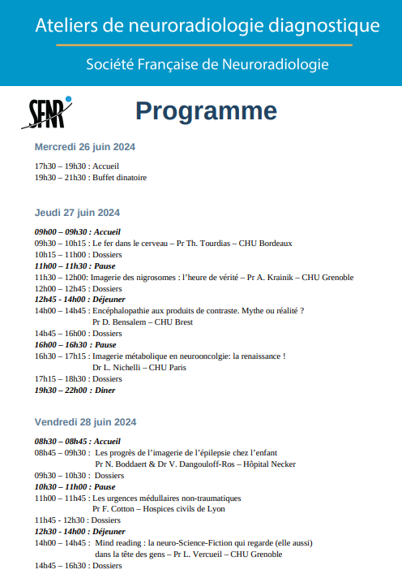

Slide 3



MRI of Nigrosomes
Time of truth ?
Prof. Dr Alexandre KRAINIK
University Hospital of GRENOBLE
FRANCE

Slide 4
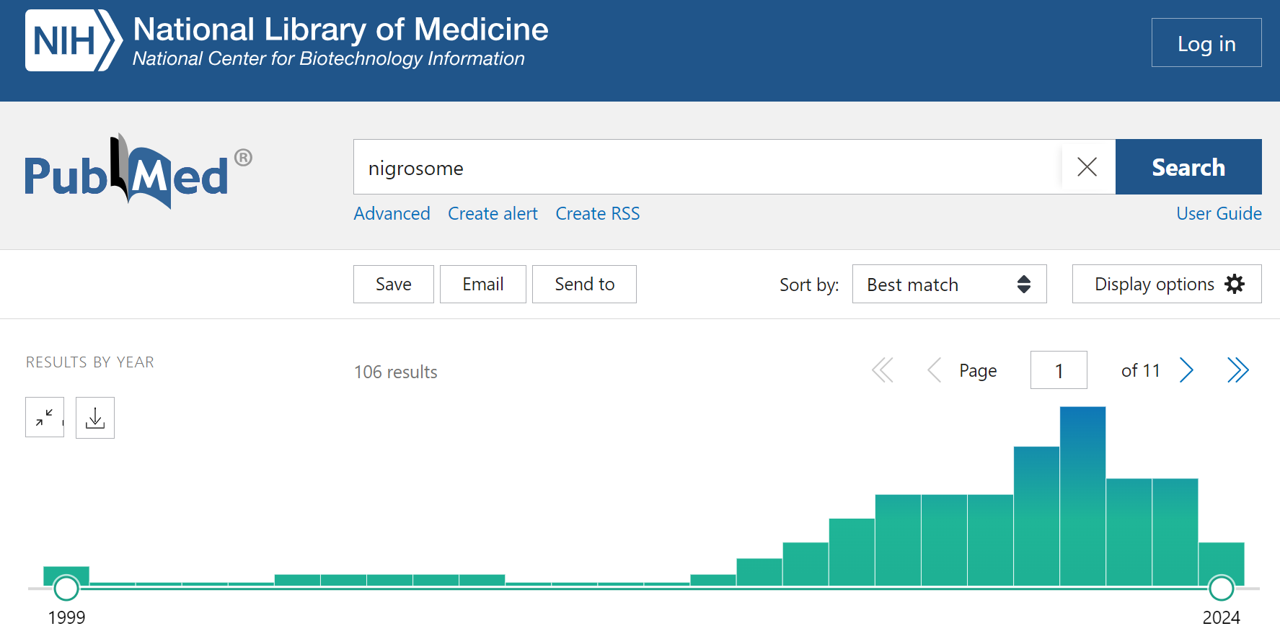
Nigrosome: a 25 years long story

Slide 5
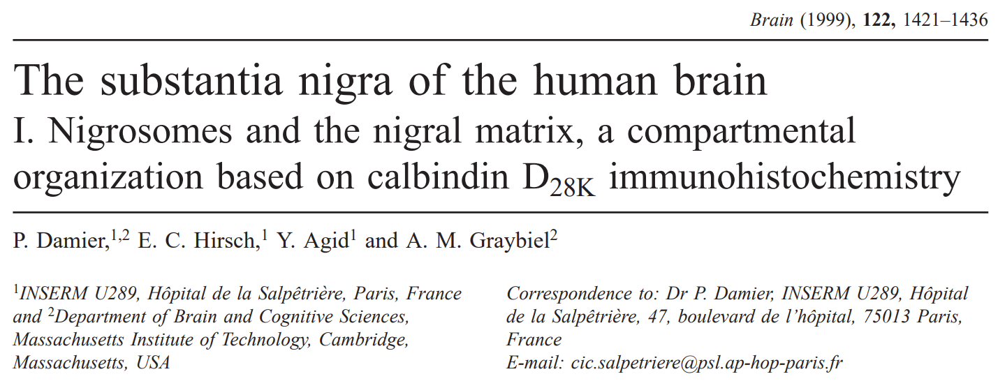
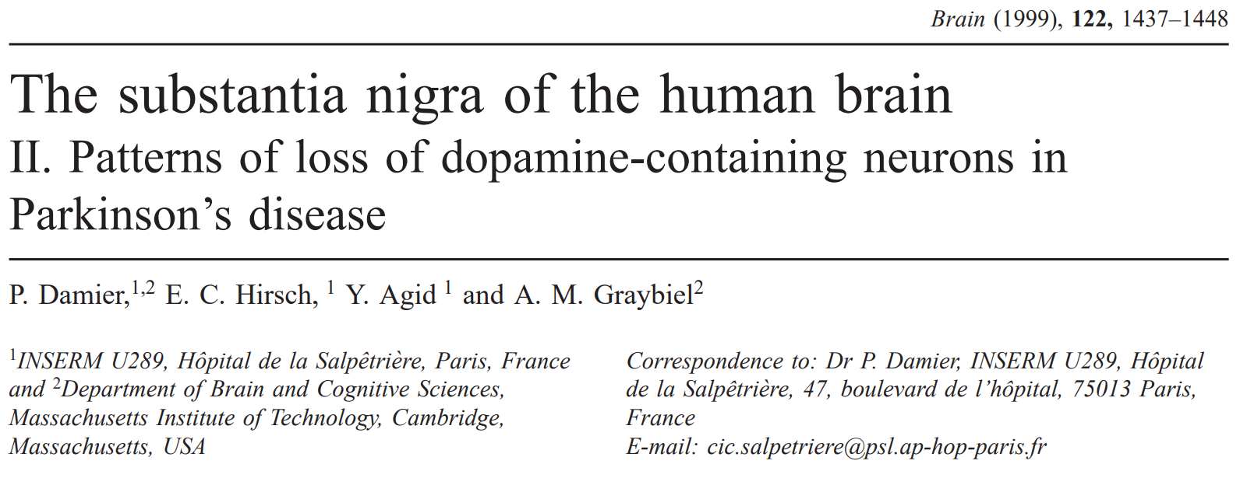
Nigrosome: an immunohistochemical evidence

Slide 6
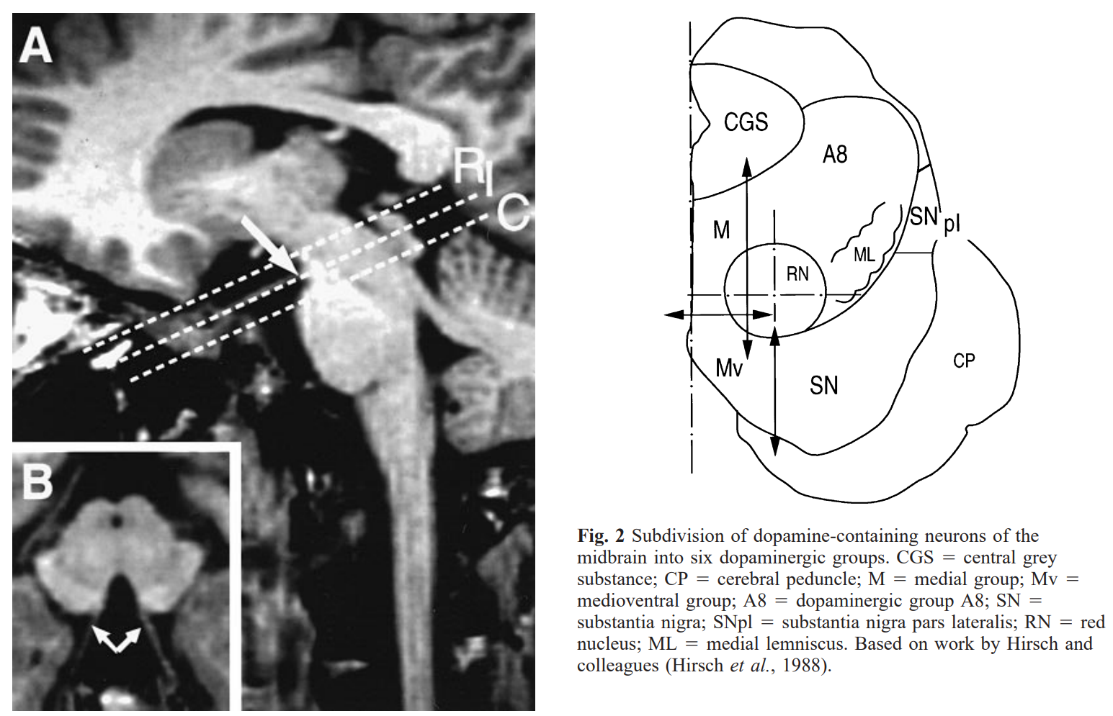
Nigrosome: an immunohistochemical evidence
Damier et al. Brain 1999
To better characterize neurodegeneration of dopaminergic neurons (Midbrain/SNc) TH+
7 post-mortem human controls
Calbindin D_{28K} staining in ventral midbrain (protein in striato-nigral afferent fibers)
Calbindin+ (60%): Nigral matrix (neuropils)
Calbindin- (40%): Nigrosomes (likely nigro-striatal afferents)

Slide 7
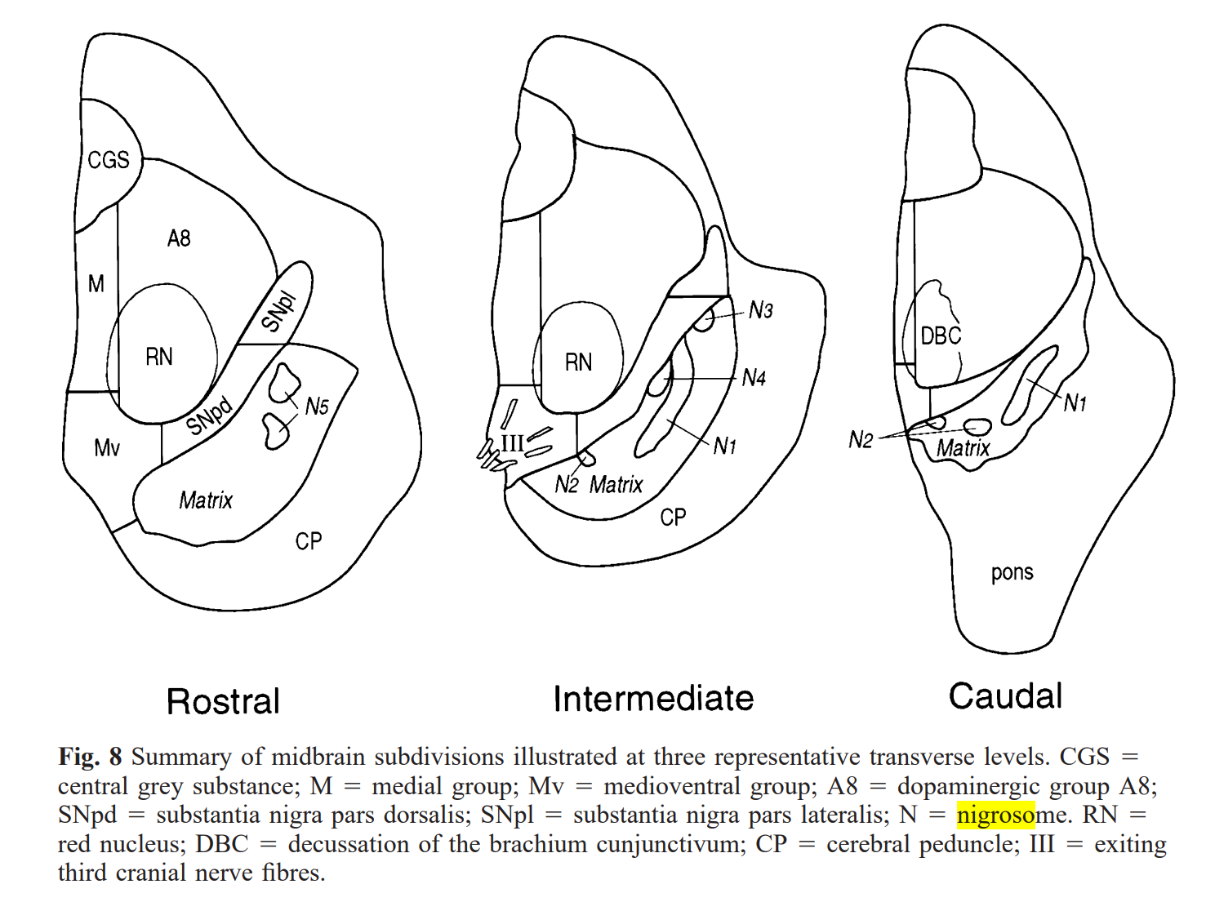
5 nigrosomes & nigrosome 1 the largest (60%)

Slide 8
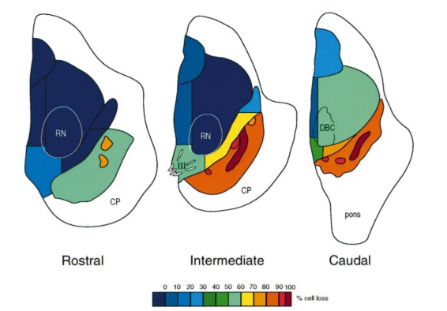
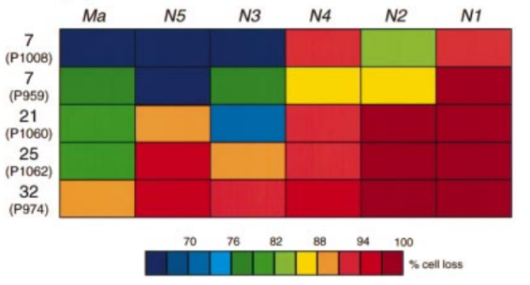
Nigrosome loss: a robust biomarker in PD
Damier et al. Brain 1999
Nigrosomes loss > Matrix loss
N1>N2>N3>N4>N5
 with PD duration

Slide 9
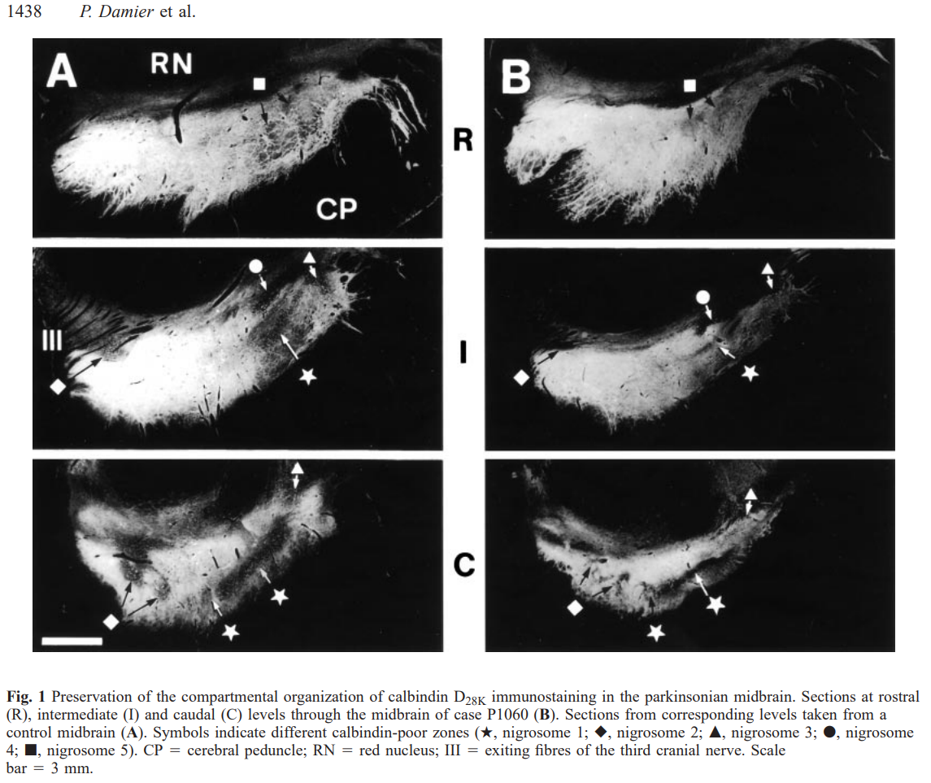
Nigrosome loss in PD

Slide 10
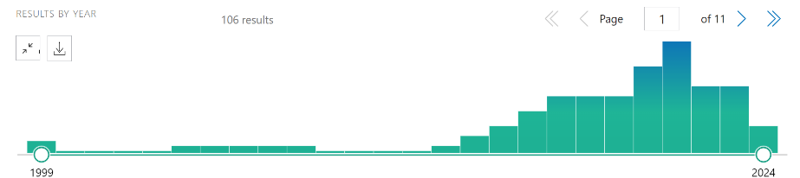
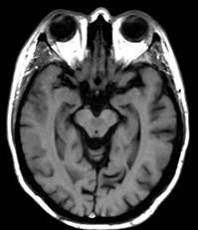
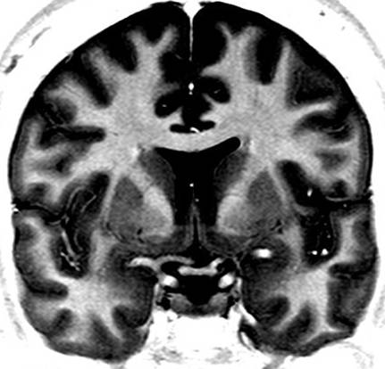
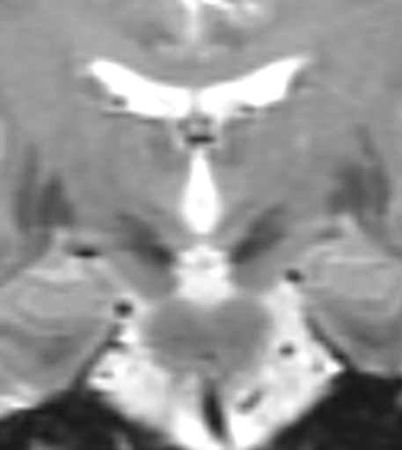
Nigrosome: in vivo imaging challenge

Slide 11
MRI of substantia nigra
IRM 4T : Substantia nigra
↓ T2ρ (hS): iron depostion
↑ T1ρ (hS): neural loss & neuromelanin loss
Michaeli, Mov Dis 2007

Slide 12

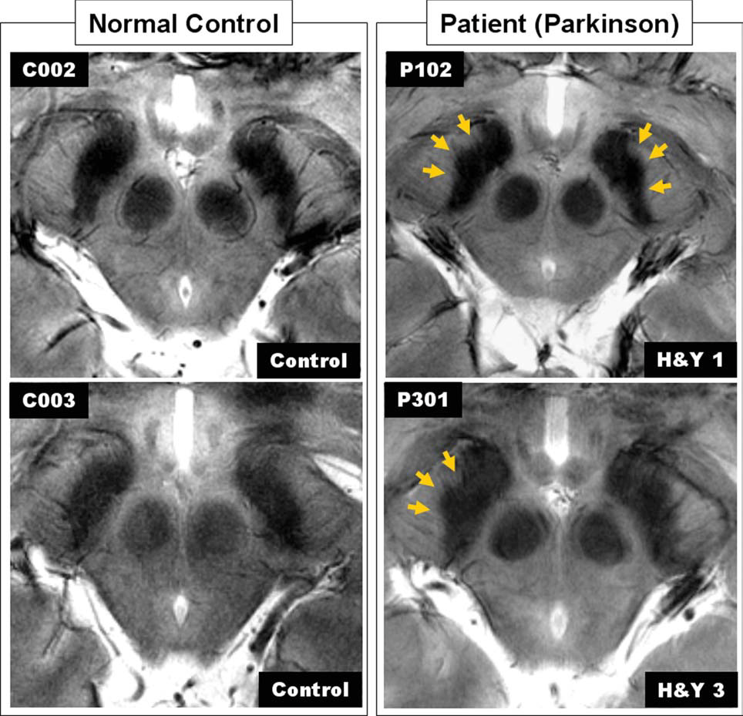
MRI of substantia nigra: Iron deposition
  7T: 2D T2* EG with specific coil (12.5’)
Richelieu sign?
See further studies in R2* and QSM
Cho, Mov Dis 2011

Slide 13
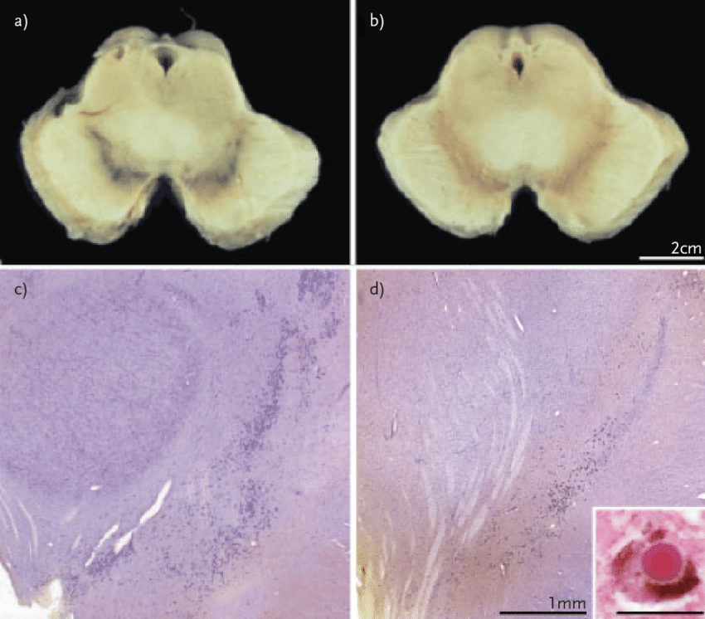
MRI of substantia nigra: Neuromelanin
NM pigment: oxidized catecholamines trapped within autophagic intraneural organelles
Colocalization with lipids, iron, pesticides, antipsychotic drugs,… chloroquine
Dopaminergic neurons of SN, ventral tegmental area
Noradrenergic neurons of locus coeruleus (LC), ventrolateral reticular formation and nucleus of the solitary tract in the medulla oblongata
Protective antioxidative role against iron toxicity
In Parkinson’s disease
Nigral degeneration➔ NM release
➔ Autoimmune microglial response
➔ metals and toxic release: Oxidative stress
➔ alpha-synuclein accumulation
Double Biological Role of Neuromelanin in the Human Brain and Its Importance in Parkinson's Disease, 2011

Slide 14
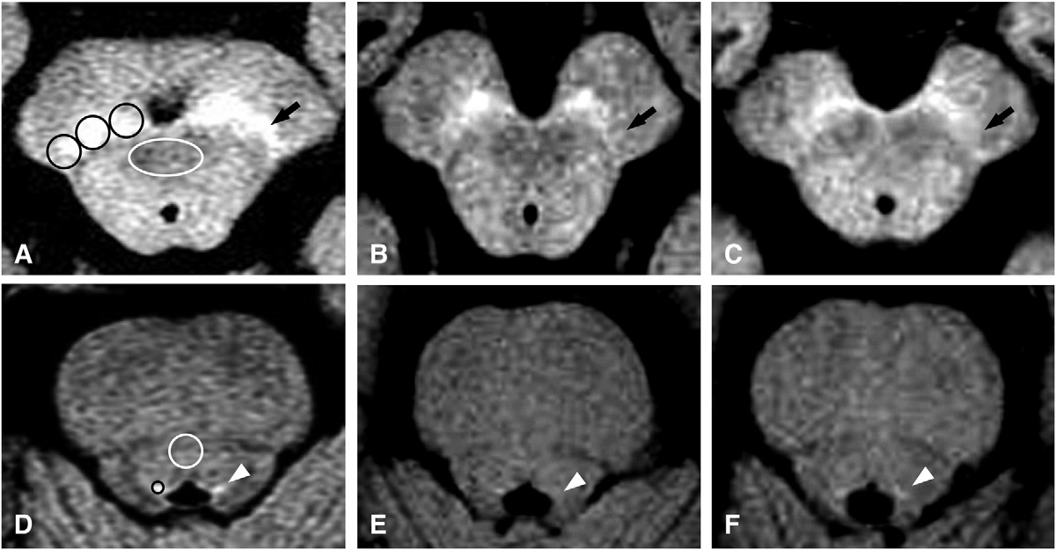
MRI of substantia nigra: Neuromelanin
3T>1.5T : FSE T1WI (600/14/90°nex=8; th=2,5); poss MT
from 12’ to 2’
Controls
Early PD
Late PD
HC
PD
Michaeli, Mov Dis 2007
Ohtsuka, Neurosci let 2013

Slide 15
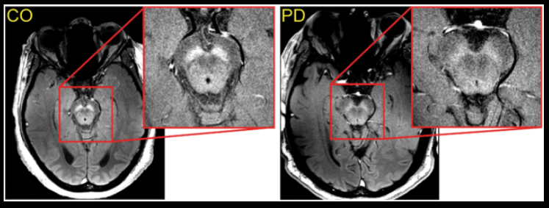
MRI of neuromelanin in PD
See review by Bae et al. Radiology 2021
Lateral to central and medial depletion
NM depletion correlated to clinical symptoms & severity, PD duration
Metanalysis Wang et al Neurol Sci 2019 Se=82%; Sp=82%
Sulzer npj Parkinson’s disease 2018

Slide 16
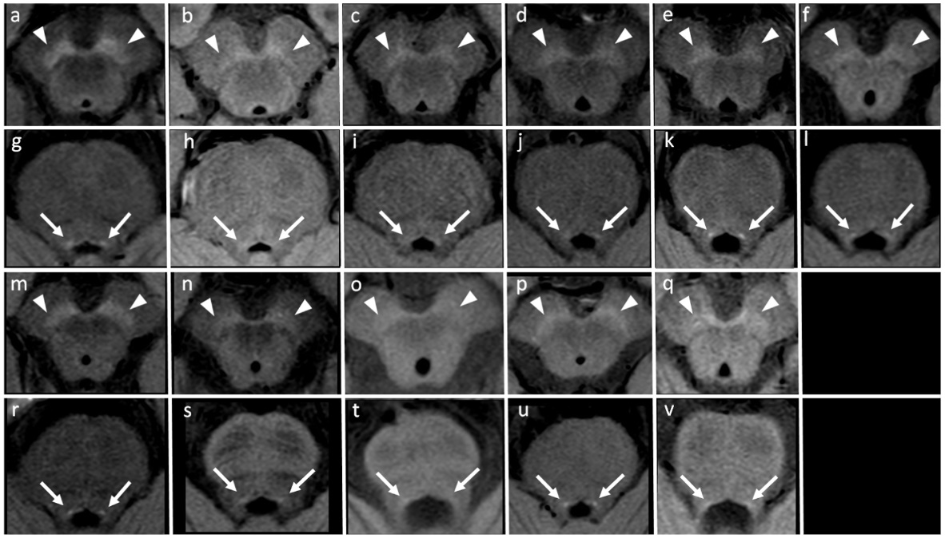
MRI of neuromelanin in PD & Park+
HST1 in SN, LC
 NM in PD, DLB, PSP, MSA
Normal NM in VaP, DiP, CBS, ET
HC
PD
DLB
VaP
DiP
PSP
CBS
MSAp
MSAc
ET
SCA+PD
Matsura Park Rel Dis 2021

Slide 17


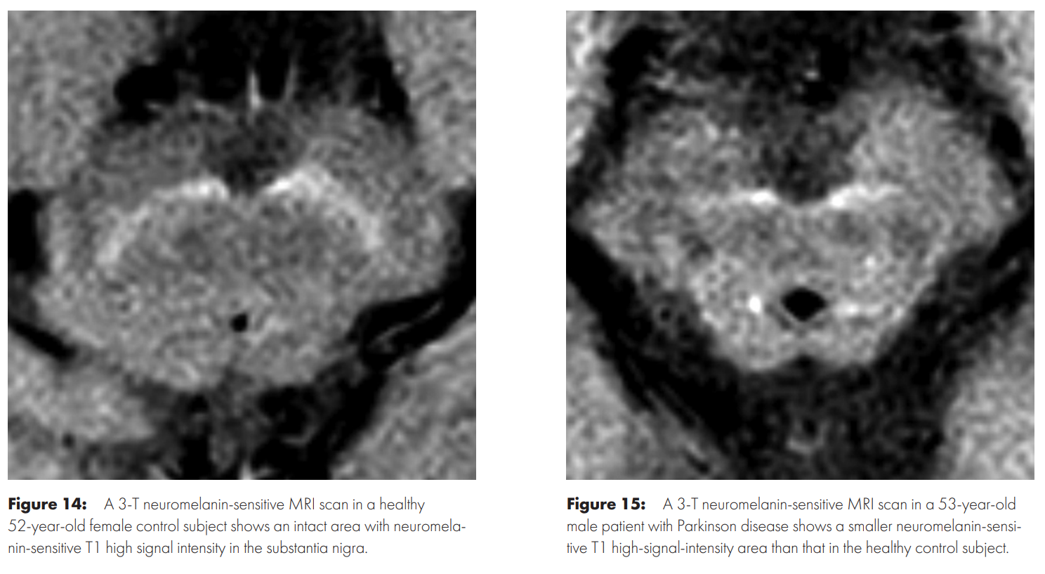
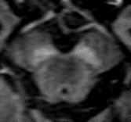
MRI of substantia nigra: Neuromelanin
Look for the loss of Mickey large white eyebrows !
Do NM MRI & get your own visual experience+++
See review by Bae et al. Radiology 2021
3T UH Grenoble: HC

Slide 18
No Nigrosome yet

Slide 19

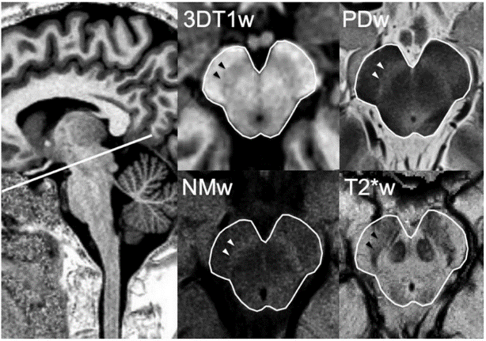
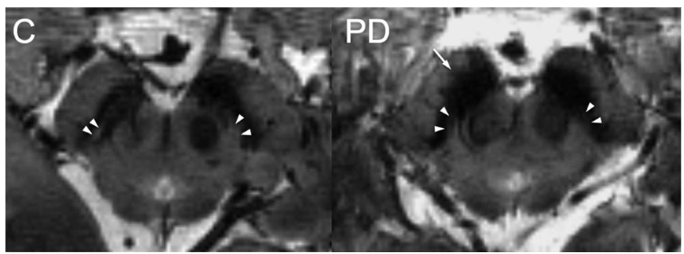
MRI of Nigrosomes 1
Conventional 3T MR
Case courtesy of Dr. Reem Alketbi, Radiopaedia.org, rID: 54700
7T 3DT2*
Lehericy Mov Dis 2014

Slide 20
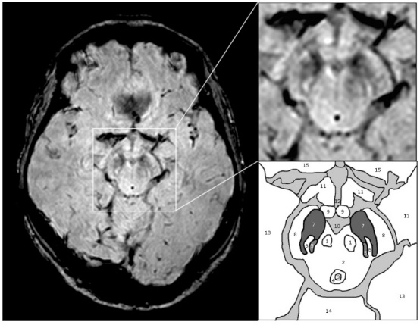
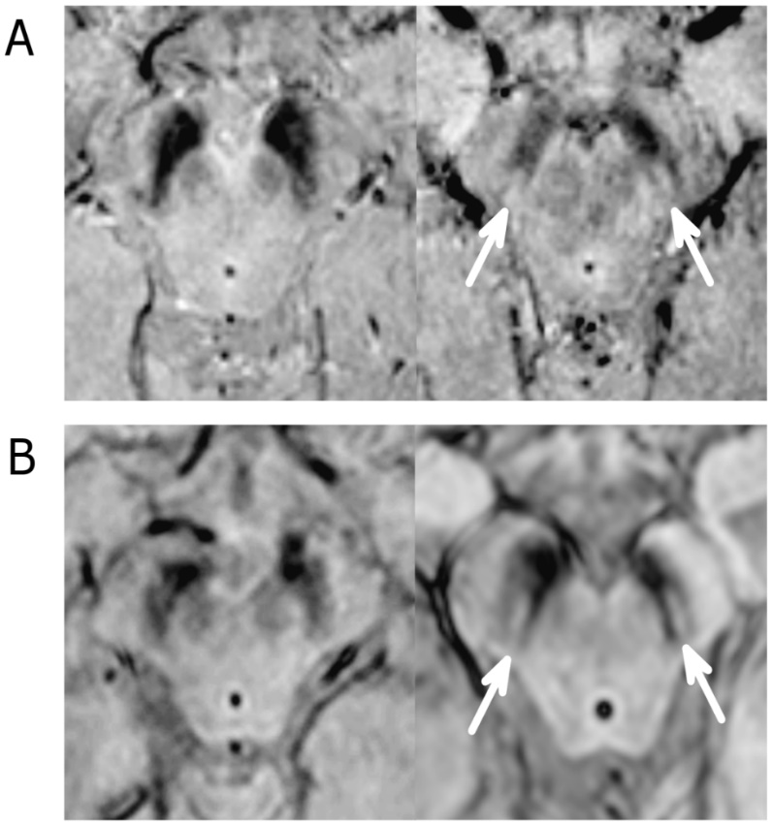
MRI of Nigrosomes 1: SWI !
SWI 3T MR: swallow tail
PD
Control
3T, Philips HR-SWI
3D gradient echo (FEEPI, TR/TE 60/30, echo train length 5, Flip angle 19°
number of slices: 70, voxel size0.55 x 0.55 x 0.7 mm
TA : 4 minutes 26 seconds, only magnitude image used
PD
Control
Schwarz PLOS ONE 2014

Slide 21
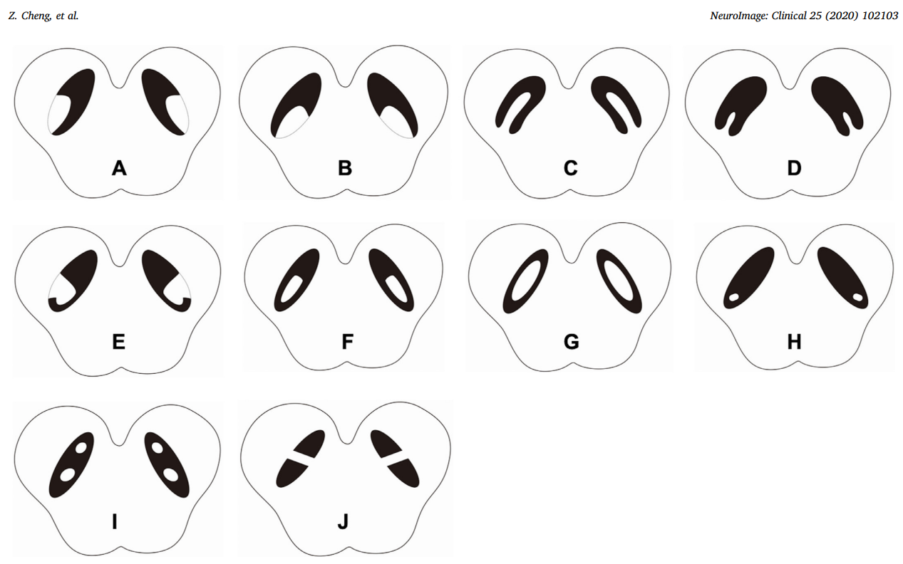
Nigrosome shapes

Slide 22
Nigrosomes 1
PPV 25%, NPV 97% to diagnose PD or DLB
UH Grenoble experience 1010 pts (30 PD, 14 DLB)
C. Bonardel MD Thesis SFNR 2023
HC UH Grenoble experience
C. Bonardel MD thesis (SFNR 2023)
PD
Visualisation of N1 (3T)
  18 months 2020-2022
  967 controls
  Bilateral visibility
  >3/4 readers’ agreement
  Nigrosome loss sign
    True Negative 89% / FP 11%
    FP increases with
      Patient’s young age
      Readers experience
N1 loss (3T)
Stezin Eur Radiol 2018
  Se/Sp= 98/94%
  PPV/NPV=94/98%
  N1 asym = 65% contro motor sev
UH Grenoble experience (30 PD)
  Se/Sp= 93/88%

Slide 23
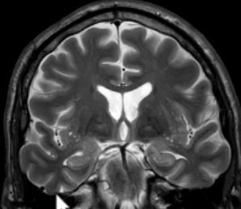
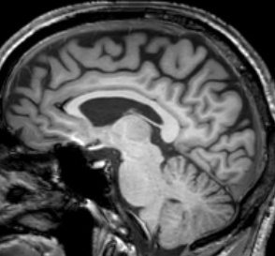
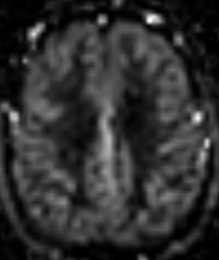
M61y, atypical EP sd. No cognitive dis.
72169896

Slide 24
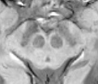


M61y, atypical EP sd. No cognitive dis.
72169896
DOPA-sensible
Parkinson’s disease

Slide 25
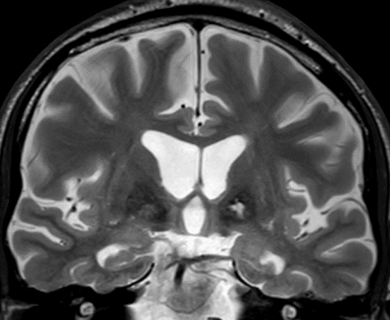
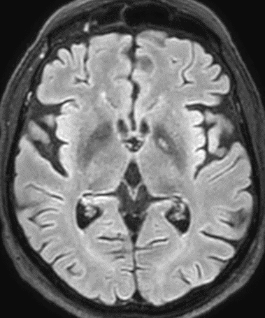
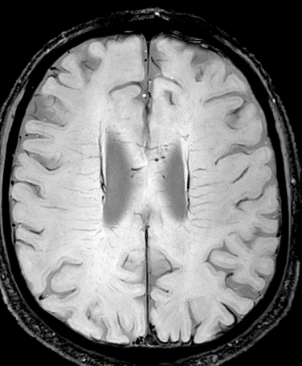
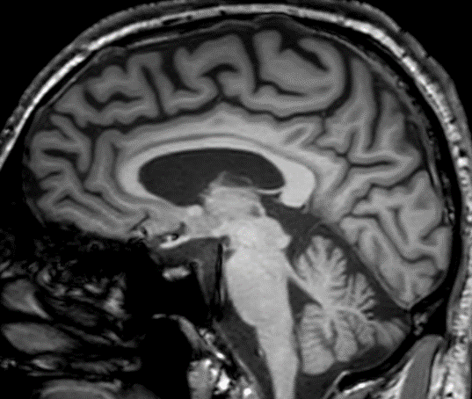
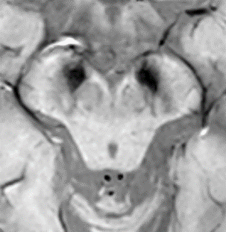
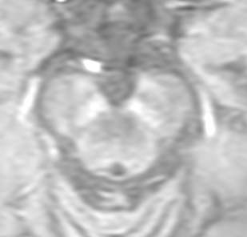
M61y. Cognitive decline. EP sd. Hx TBI and carotid dissection.
72073659
Vascular Parkinsonism

Slide 26
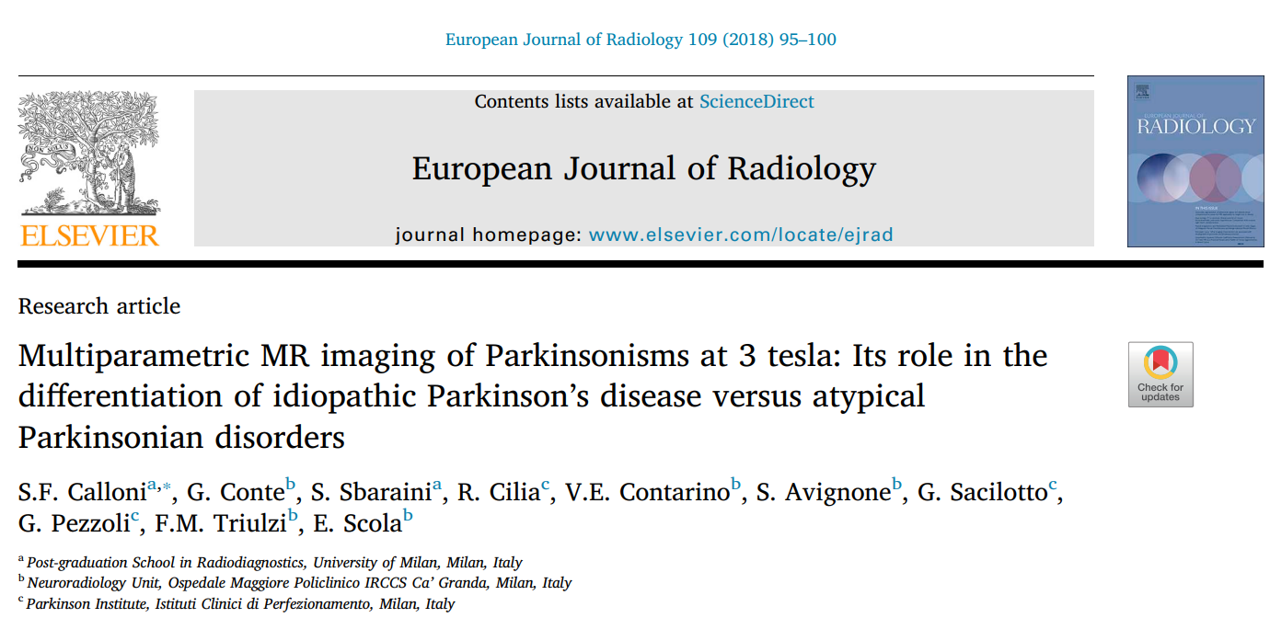
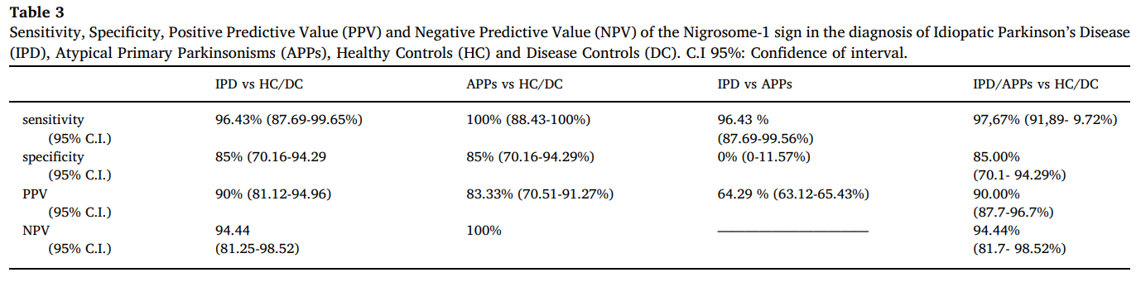
To diagnose PD or DLB among controls
Se 84%, Sp 89%
PPV 25%, NPV 97%
UH Grenoble experience 1010 pts (30 PD, 13 DLB)
C. Bonardel MD Thesis SFNR 2023

Slide 27
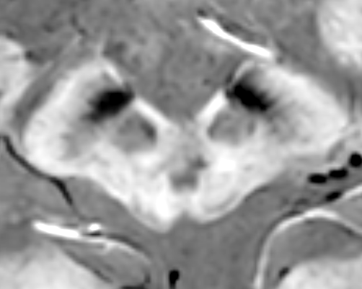
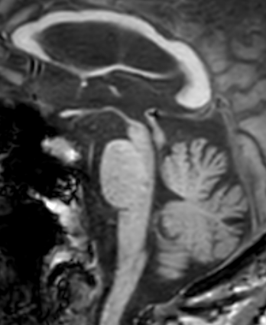
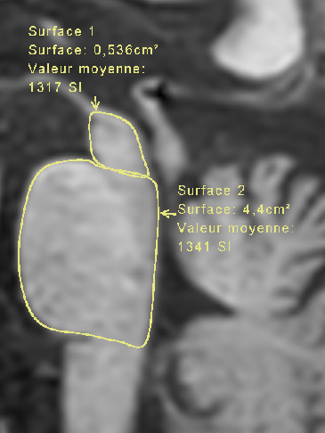
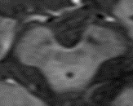
PSP
W80y 94090474
Personal experience (>2021)
N1 loss 6/6
0.12

Slide 28
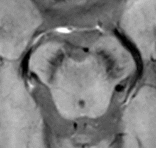
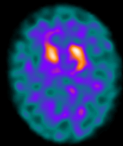
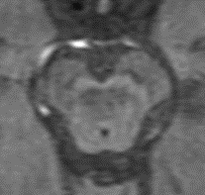
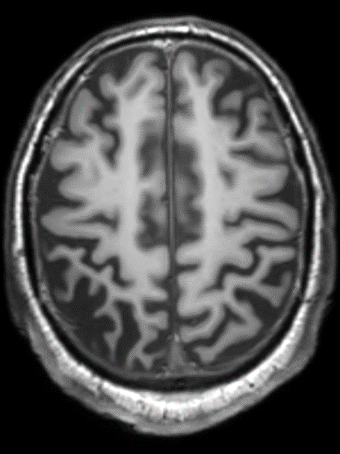
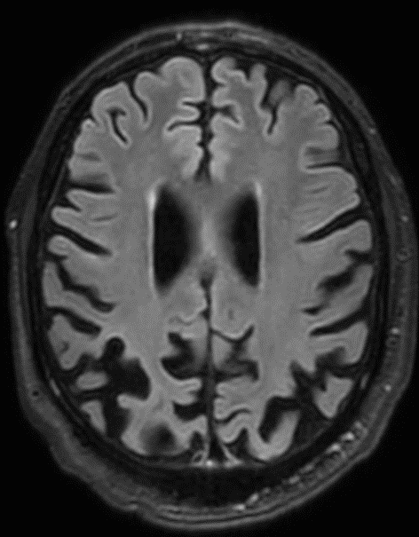
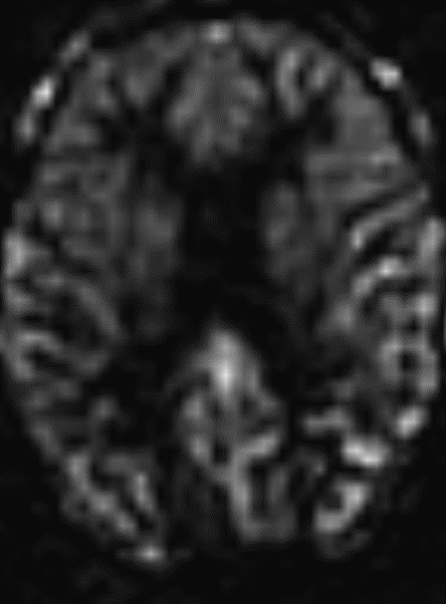
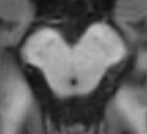
CBD
M66y CB Sd L>R 401576
No reference
UH Grenoble experience (>2021)
N1 loss 4/4

Slide 29
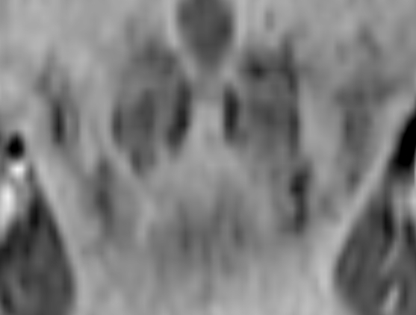





MSAc
M50y 52038933
UH Grenoble experience (>2021)
N1 loss in MSA 11/12

Slide 30



MSAp
M64y 94110080
UH Grenoble experience (>2021)
N1 loss in MSA 11/12

Slide 31



MSAp
F75y 93028373
UH Grenoble experience (>2021)
N1 loss in MSA 11/12

Slide 32

Nigrosome 1 in dementia
Nigrosome loss in DLB
Se 63%, Sp 79%
PPV 44%, NPV 89%... Shams AJNR 2017
Se 80% Sp 76% Rizzo J Alz Dis 2019
Se 62%, Sp 87%
UH Grenoble experience (13 DLB)
E. Sayilir MD Thesis ECR 2024
Haller Radiology 2021

Slide 33


Nigrosomes 1
Rizzo J Alz Dis 2019

Slide 34





F67a, Memory decline and sleep disorders
226055
Alzheimer

Slide 35





M85a. Fluctuating cognitive decline (memory, dysexecutive sd, behaviour). Visual hallucinations. No EP sd.
747106
DLB

Slide 36
Few tips to see nigrosomes

Slide 37


Acquisition plane and MPR
Adapted from Kim et al. Br J Radiol 2019

Slide 38

Not too thin slices: 1-2mm

Slide 39


Look at magnitude images may help
SWI
Magnitude
GE 1.5T

Slide 40


AI…WIP

Slide 41
Take home messages
Nigrosome loss in MRI
In addition
MR Protocol
SWI
T1 NM
3DT1 GRE-IR
ASL 3D
3DFLAIR
DWI
Opt: QSM; T2
SWI quality
  FP ≅ 10% ➔ ↓PPV when low prevalence
Useful in NDs and DDx
  Movements disorders
    Se ≅ 90%
    Rare FN Sp >90
  Dementia
    FN 1/3 in DCL
Get trained & experience
 SN neuromelanine
BV changes
Perfusion changes (ASL)
DatScan & PET FDG
Segmentation & AI…WIP

Slide 42


Thank you for your attention
Neuroradiology
Grenoble
France
Akrainik.edu@gmail.com

